Slide 1
Interfaces In Java

Slide 2
What are Interfaces
The interface in Java is a mechanism to achieve abstraction. There can be only abstract methods in the Java interface, not the method body. It is used to achieve abstraction and multiple inheritances in Java using Interface. In other word.
you can say that interfaces can have abstract methods and variables. It cannot have a method body. Java Interface also represents the IS-A relationship.

Slide 3
When we decide on a type of entity by its behavior and not via attribute we should define it as an interface.
Let’s consider the example of vehicles like bicycles, cars, bikes, etc they have common functionalities. So we make an interface and put all these common functionalities. And lets Bicycle, Bike, car, etc implement all these functionalities in their own class in their own way
Syntax for Java Interfaces
interface {
// declare constant fields
// declare methods that abstract
// by default.
}

Slide 4
To declare an interface, use the interface keyword. It is used to provide total abstraction.
That means all the methods in an interface are declared with an empty body and are public and all fields are public, static, and final by default.
A class that implements an interface must implement all the methods declared in the interface. To implement the interface, use the implements keyword.

Slide 5
Uses of Interfaces in Java
It is used to achieve total abstraction.
Since java does not support multiple inheritances in the case of class, by using an interface it can achieve multiple inheritances.
Any class can extend only 1 class, but can any class implement an infinite number of interfaces.
So, the question arises why use interfaces when we have abstract classes?

Slide 6
// A simple interface
interface Player
{
final int id = 10;
int move();
}

Slide 7
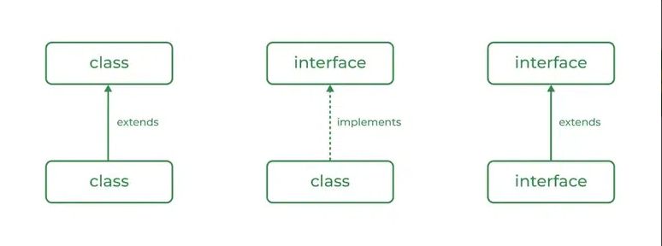
Relationship Between Class and Interface
A class can extend another class similar to this an interface can extend another interface. But only a class can extend to another interface, and vice-versa is not allowed.

Slide 8
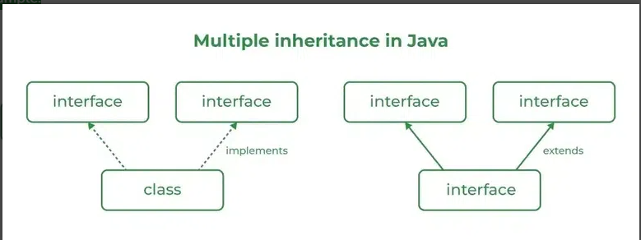
Multiple Inheritance in Java Using Interface
Multiple Inheritance is an OOPs concept that can’t be implemented in Java using classes. But we can use multiple inheritances in Java using Interface. let us check this with an example.

Slide 9
New Features Added in Interfaces in JDK 8
There are certain features added to Interfaces in JDK 8 update mentioned below:
1. Prior to JDK 8, the interface could not define the implementation. We can now add default implementation for interface methods. This default implementation has a special use and does not affect the intention behind interfaces.
So with the help of default implementation, we will give a default body for the newly added functions.

Slide 10
Another feature that was added in JDK 8 is that we can now define static methods in interfaces that can be called independently without an object.
From Java 9 onwards, interfaces can contain the following also:
Static methods
Private methods
Private Static methods

Slide 11
// Java program to demonstrate working of interface
import java.io.*;
A simple interface
interface In1 {
public, static and final
final int a = 10;
// public and abstract
void display();
}

Slide 12
// A class that implements the interface.
class TestClass implements In1 {
// Implementing the capabilities of
// interface.
public void display(){
System.out.println("Hello");
}

Slide 13
// Driver Code
public static void main(String[] args)
{
TestClass t = new TestClass();
t.display();
System.out.println(a);
}
}

Slide 14
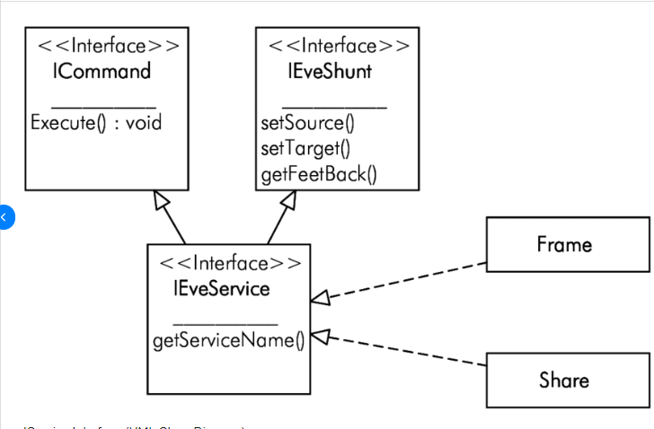
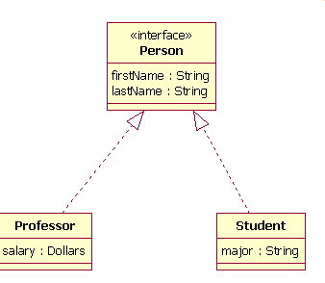
Interfaces In Class Diagrams

